Slide 1

Implementation of the Water Resources Classification System and Determination of the Resource Quality Objectives for Significant Water Resources in the Letaba Catchment
9e: Consequences and ranking of operational scenarios
Integrated Ranking
3 April 2014
Presented by:
Pieter van Rooyen

Slide 2
Integrated Ecology & Ecosystem Services Scoring
All biophysical nodes form part of calculation:
  EWR sites most important.
  Same weight for other nodes (lower than EWR sites)
Focus on EWR sites due to influence of scenarios.
Letaba System evaluated as a unit – all tributaries influence the KNP, key ecological driver.

Slide 3
Variable Scores & Weights
Variables | Scenarios
 | PES | REC | 5 | 6 | 9 | 10
Ecological Status | 0.93 | 1.00 | 0.81 | 0.85 | 0.89 | 0.90
Ecosystem Services | 1.00 | 1.07 | 0.94 | 0.95 | 0.96 | 0.96
Economic Indicator (GDP) (R Millions) | 2 099 | 1 699 | 3 245 | 2 641 | 2 614 | 2 852
Employment | 21 371 | 14 738 | 33 641 | 25 901 | 28 813 | 29 272
Variables | Weights
Ecological Status | 0.5
Ecosystem Services | 0.05
Economic Indicator | 0.2
Employment | 0.25
50% Ecology
50% Socio-Economic

Slide 4
Visualisation of Variables Scores

Slide 5
Overall Ranking (Two Rank Methods)
Method | Scenarios
 | PES | REC | 5 | 6 | 9 | 10
Overall Score (Rank Order method) | 3.65 | 3.75 | 3.25 | 2.65 | 3.275 | 4.425
Rank (1 = best, 6 = worse) | 3 | 2 | 5 | 6 | 4 | 1
Overall Score (Normalisation Method) | 0.4772 | 0.5500 | 0.4500 | 0.3811 | 0.5265 | 0.5885
Rank (1 = best, 6 = worse) | 4 | 2 | 5 | 6 | 3 | 1

Slide 6
Sensitivity Analysis
Evaluated various combinations of variable weights
Scenario 10 is either first or second
When Scenario 10 is second, either Scenario 5 or the REC Scenario is ranked first - two extreme scenarios.
A balances decision will not select the extreme scenarios.
Therefore Scenario 10 is preferred among scenarios.

Slide 7
Perspective on Results
Scenario 10 include additional transfers to Polokwane.
Reconciliation Strategy showed insufficient water in the Letaba to supply system’s users, no additional transfer possible.
Also, additional transfer reduces EC for EWR 1 from C to C/D.
Recommendation: Select Scenario 10 without additional transfer to Polokwane.

Slide 8
Draft Management Classes

Slide 9
Recommended Management Class Criteria Table
 |  | % EC representation at units represented by biophysical nodes in an IUA |  |  |  |  | Prominent Ecological Categories
 |  | ≥ A/B | ≥ B | ≥C | ≥ D | < D
Class I |  | 0 | 60 | 80 | 95 | 5 | A & B
Class II |  |  | 0 | 70 | 90 | 10 | C
Class III | Either |  |  | 0 | 80 | 20 | D
 | Or |  |  |  | 100
Unit Percentages:
Length of river in a given Ecological Category divided by the total river length in an IUA .
Notes:
Se hoekom ons lengte van rivier gebruik
Gee voorbeel van iets wat in 'n A is maar net 10 % van lengte is, en res van rivier is in C. Etc - as jy net 2 nodes gehad het dan is dit 50/50.
Maar nou is 90% 'n C so dit behoort klas 2 te wees.
En maak seker jy noem dat agv catchment config, beteken dit nie dat die A wegval nie.

Slide 10
Resulting IUA Management Classes for all scenarios
Integrated Unit of Analysis | Scenarios and Management Class
 | PES | REC | 5 | 6 | 9 | 10
1 | II | II | III | III | III | III
2 | III | III | III | III | III | III
3 | III | II | III | III | III | III
4 | II | II | III | III | III | III
5 | I | I | I | I | I | I
6 | III | III | III | III | III | III
7 | XXX | III | XXX | XXX | XXX | XXX
8 | II | II | II | II | II | II
9 | II | II | III | III | III | III
10 | I | I | I | I | I | I
11 | II | I | III | II | II | II
12 | I | I | I | I | I | I
“XXX” – Scenario did not achieve Class III criteria

Slide 11
Resulting IUA Management Classes for all scenarios
Integrated Unit of Analysis | Scenario 10 | Draft Recommended Scenario’s Management Classes
1 | III | II
2 | III | III
3 | III | III
4 | II | II
5 | I | I
6 | III | III
7 | XXX | III
8 | II | II
9 | III | III
10 | I | I
11 | II | II
12 | I | I

Slide 12
Draft Recommended ECs and MCs
Nodes | River | IUA | EC | MC |  | Nodes | River | IUA | EC | MC
B81A-00242 | Broederstroom | 1 | C | II |  | B82A-00168 | Middel Letaba | 7 | C | III
B81A-00256 |  |  | D |  |  | B82B-00173 | Koedoes |  | D
B81A-00263 |  |  | D |  |  | B82C-00175 | Brandboontjies |  | E
B81A-00270 | Broederstroom |  | C |  |  | B82D-00163 | Lebjelebore |  | C
B81B-00233 | Mahitse |  | C |  |  | B82D-00154 | Middel Letaba |  | D
B81B-00234 | Mahitse |  | C |  |  | B82D-00166 | Mosukodutsi |  | D
B81B-00246 | Politsi |  | C |  |  | B82D-00146 | Middel Letaba |  | E
B81B-00251 |  |  | D |  |  | B82E-00149 | Khwali | 8 | B | II
B81B-00269 | Morudi |  | B |  |  | B82E-00150 | Little Letaba |  | C
B81B-00227 | Mahitse |  | D |  |  | B82F-00141 | Soeketse |  | C
B81B-00240 | Politsi |  | C |  |  | B82F-00128 | Little Letaba |  | C
B81B-00247 | Great Letaba |  | C |  |  | B82F-00137 | Little Letaba |  | D
EWR1 | Great Letaba |  | C |  |  | EWR5 | Little Letaba | 9 | C/D | III
B81D-00277 | Thabina | 2 | D | III |  | B82J-00165 | Little Letaba |  | C/D
B81D-00280 | Bobs |  | B |  |  | B82J-00178 | Little Letaba |  | C/D
B81D-00296 | Mothlaka-Semeetse |  | B |  |  | B82J-00201 | Little Letaba |  | C/D
EWR2 | Letsitele |  | D |  |  | B82J-00207 | Little Letaba |  | C/D
B81D-00272 | Letsitele |  | C |  |  | B82H-00127 | Nsama | 10 | C | I
B81C-00245 | Great Letaba | 3 | C | III |  | B82H-00139 | Magobe |  | B
B81E-00213 | Nwanedzi |  | D |  |  | B82H-00157 | Nsama |  | B
B81E-00244 | Great Letaba |  | D |  |  | B82J-00153 | Nalatsi |  | A
EWR3 | Great Letaba | 4 | C | II |  | B82J-00159 | Byashishi |  | A
B81F-00212 | Great Letaba |  | C |  |  | B82J-00197 | Ka-Malilibone |  | B
B81F-00215 | Great Letaba |  | C |  |  | B83A-00220 | Letaba | 11 | B | II
B81F-00218 | Great Letaba |  | C |  |  | B83A-00230 | Letaba |  | C
B81F-00231 | Great Letaba |  | C |  |  | EWR6 | Letaba |  | C
B81J-00209 | Great Letaba |  | C |  |  | B83A-00252 | Letaba |  | C
EWR4 | Great Letaba |  | C |  |  | B83D-00250 | Letaba |  | C
B81F-00228 | Reshwele | 5 | B | I |  | EWR7 | Letaba |  | C
B81F-00232 | Makwena |  | B |  |  | B83E-00265 | Letaba |  | C
B81F-00189 | Merekome | 6 | C | III |  | B83A-00193 | Shipikani | 12 | A | I
B81F-00203 | Lerwatlou |  | C |  |  | B83A-00238 | Nharhweni |  | A
B81G-00164 | Molototsi |  | D |  |  | B83A-00254 | Ngwenyeni |  | A
B81H-00162 | Metsemola |  | C |  |  | B83B-00161 | Tsende |  | A
B81H-00171 | Molototsi |  | D |  |  | B83D-00204 | Manyeleti |  | A
B81J-00187 | Mbhawula |  | C |  |  | B83D-00208 | Makhadzi |  | A

Slide 13
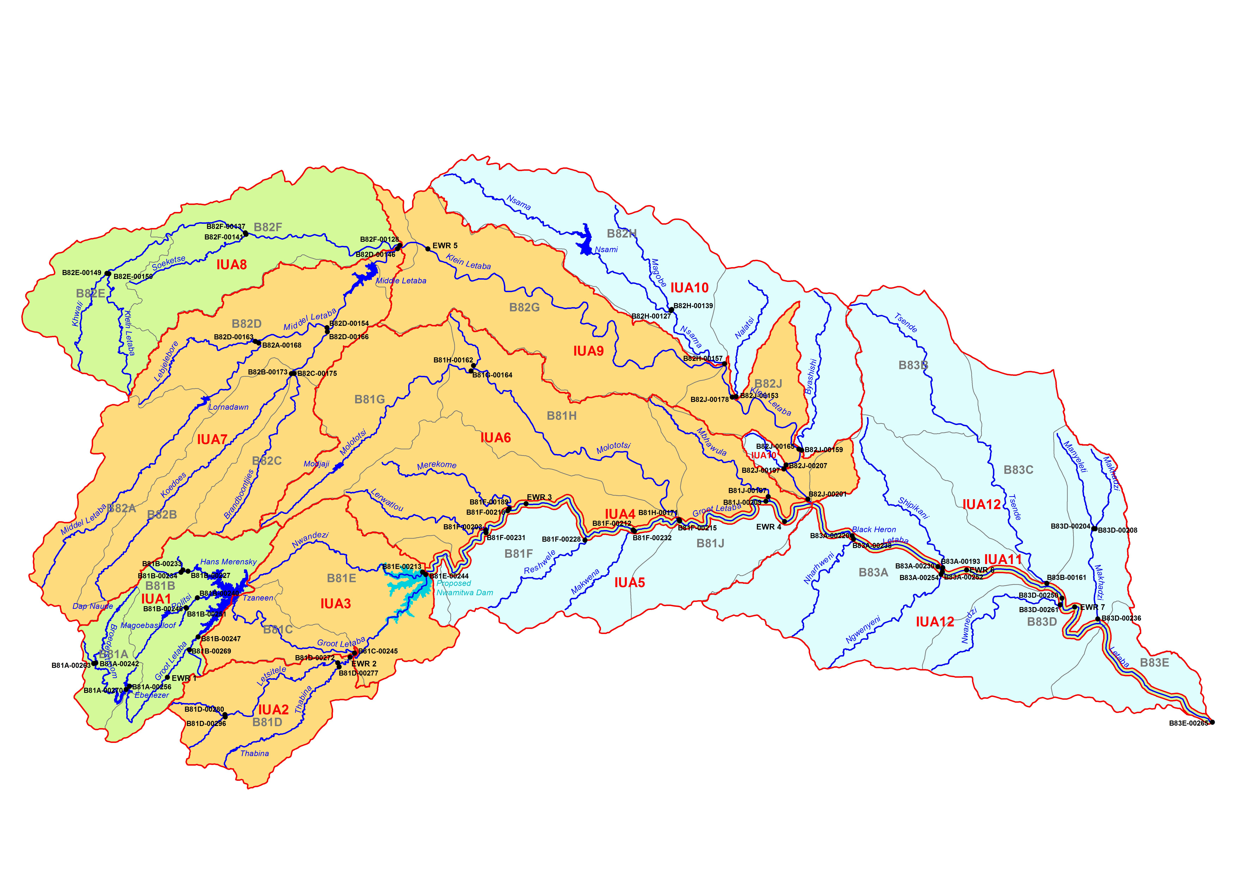
Implication of Management Classes
MC I
MC II
MC III
IUA 4 (Letaba – Nwamitwa to Klein Letaba)
IUA 11 (Letaba in KNP)
MC II

Slide 14
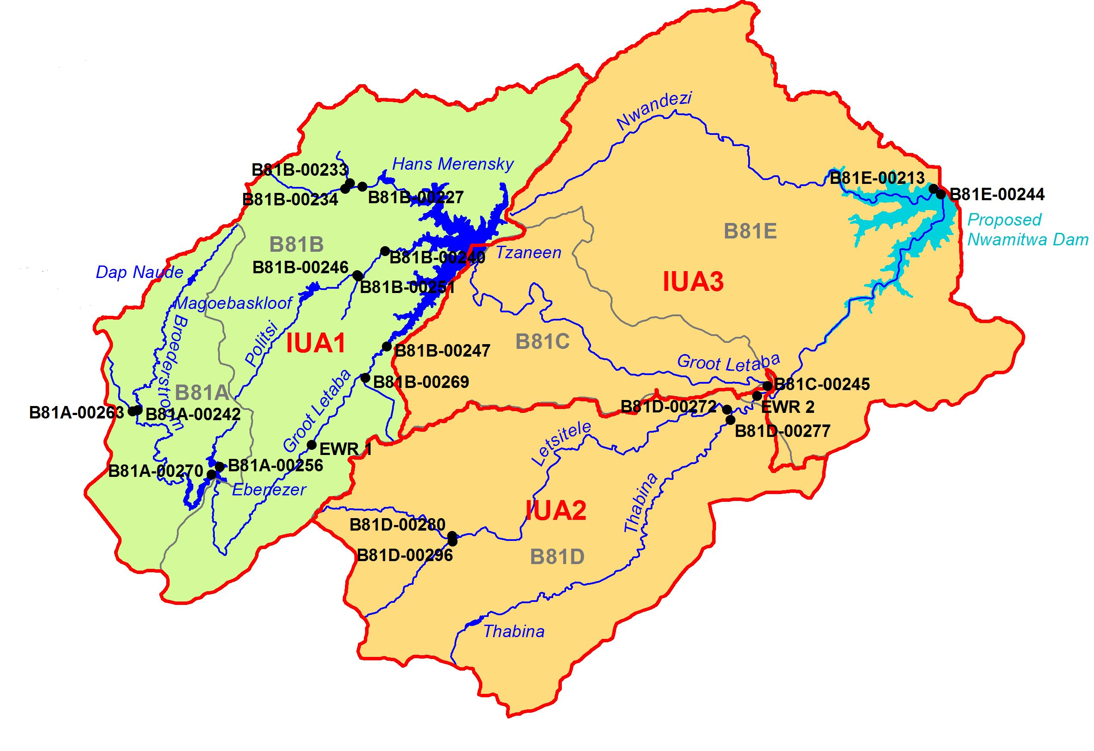
MC US of proposed Nwamitwa Dam
IUA 1I (Letaba US of Tzaneen Dam)
Forestry, run-of river & groundwater abstraction, operation of various dams.
Mostly C EC and lower.
Maintaining areas in REC in the tribs will not impact on economic activities.
Implementation of Sc 11 in main river will maintain the REC.
MC III
MC II
IUA 2 (Letsitele and Thabina)
Agriculture (formal & informal) with run-of river and groundwater abstraction. Small dams, forestry. Dense population in lower reaches.
Two SCs in B (source areas), one in a C and two in a D (longest stretch).
Maintaining areas in the REC while implementing Sc 11 will not impact on current economic activities.
IUA 3 (Letaba DS of Tzaneen to Nwamitwa)
Formal irrigation, supplied from Tzaneen and stored in various dams.
Dominated by D EC.
Implementing Sc 11 should not impact on the REC of these rivers.

Slide 15
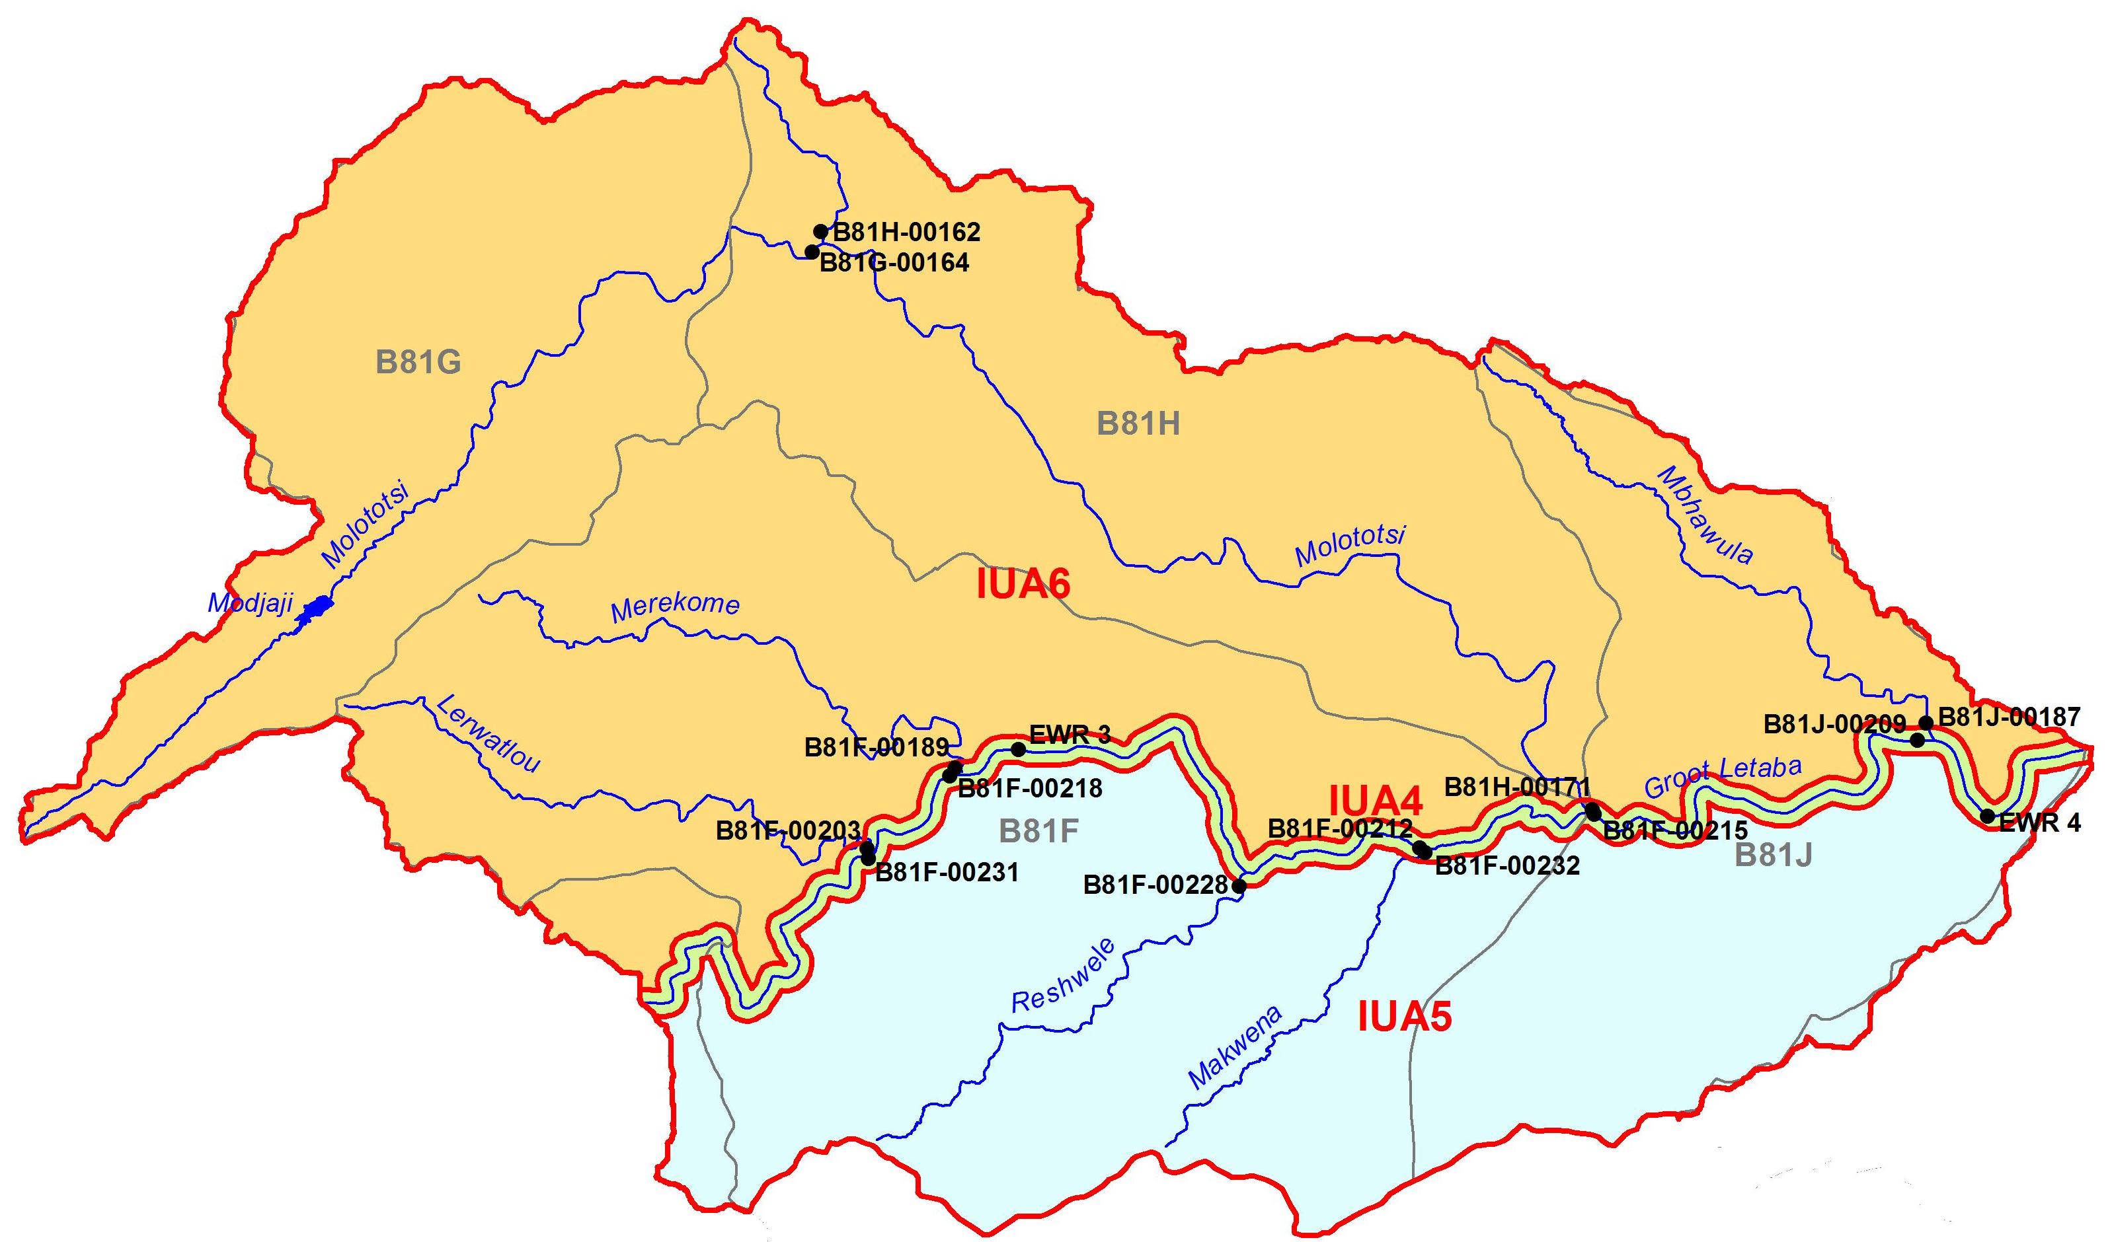
MC DS of proposed Nwamitwa Dam to Klein Letaba
IUA 6: (Northern tribs to Letaba)
3 short ephemeral rivers and sesonal Molototsi.
Water supply to urban/domestic, irrigation, subsistance agriculture.
Dominated by D.
Implementing Sc 11 will not impact on the REC and current economic activities
MC III
MC II
IUA 4: (Letaba – Nwamitwa to Klein Letaba)
Largely irrigation, some subsistance use, nature reserves
Mostly C EC. High importance – REC improvement..
Implementing Sc 11 will maintain PES with marginal improvement. WIll not achieve the REC.
MC I
IUA 5: MC I (Southern tribs to Letaba)
Seasonal systems, Largely in private nature reserves (Ndzalema).
B EC.
Scenario will not impact on REC & rivers will be maintained in a B and MC I

Slide 16
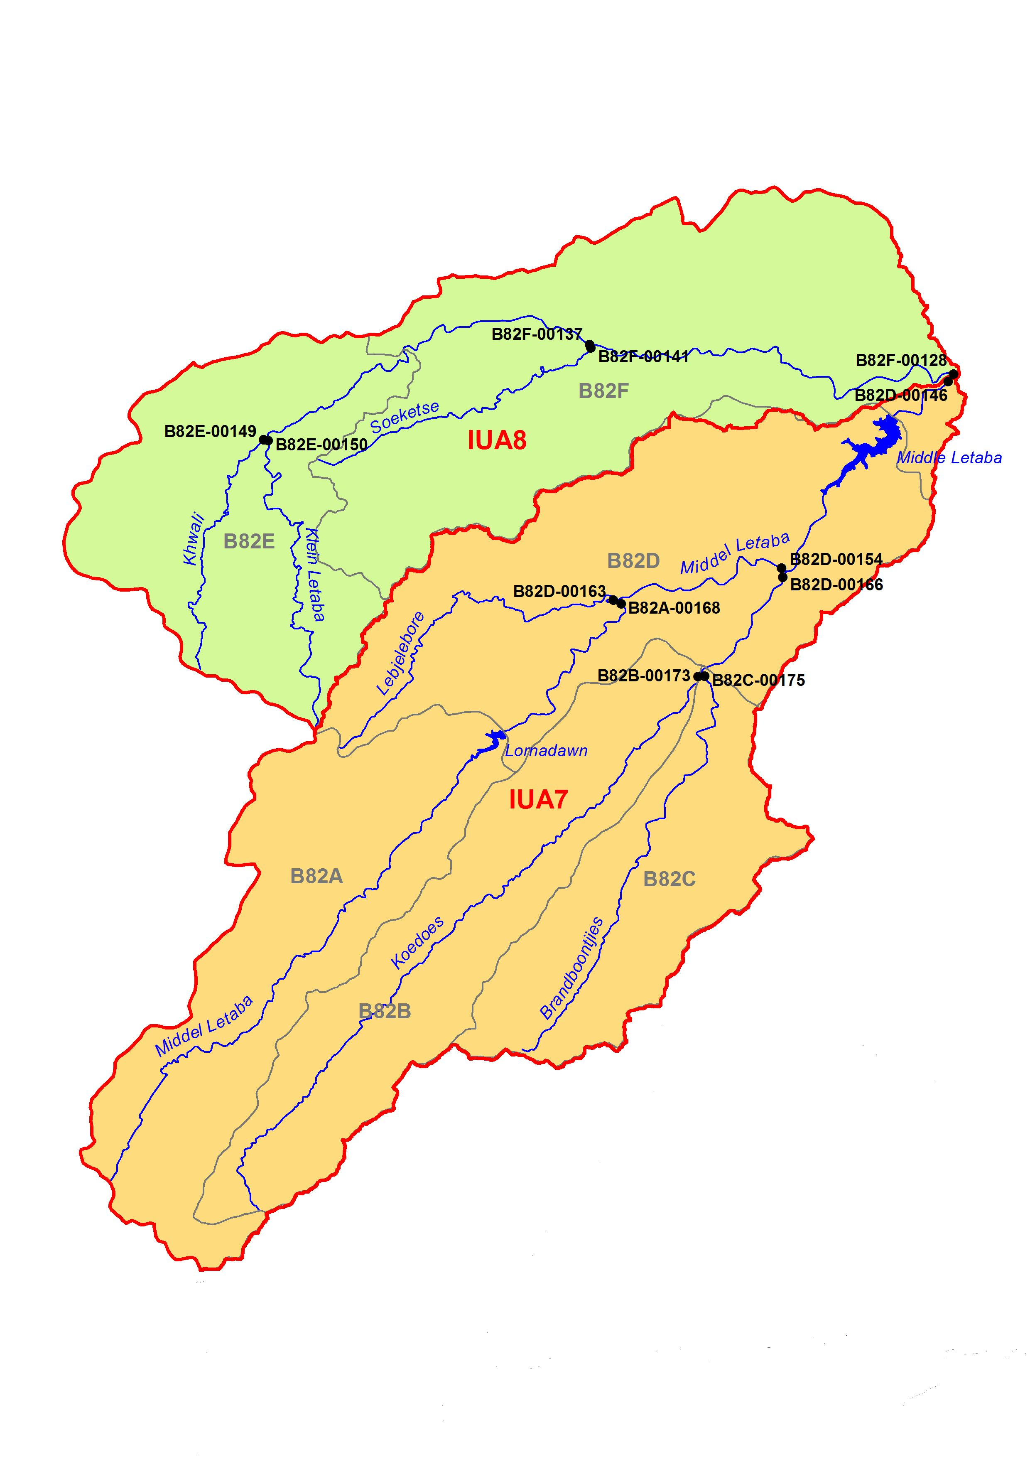
MC Upper Klein & Middle Letaba
IUA 8: (Klein Letaba US of confl with Middle Letaba)
Commercial farming and rural areas
Mostly C EC and higher.
Maintaining areas with C and higher EC will not impact on current economic activities
IUA 7 (Middle Letaba & tribs US of Middle Letaba Dam)
Extensive formal agriculture, many farm dams,
Mostly D & C PES and REC.
Two sections in an E (inundation and water quality).
Currently, % of E rivers are such that IUA does not comply to MC III criteria.
As it will be difficult to improve rivers, IUA to be managed in a MC III.
Sc 11 does not impact on IUA or current economic activities.
MC II
MC III

Slide 17
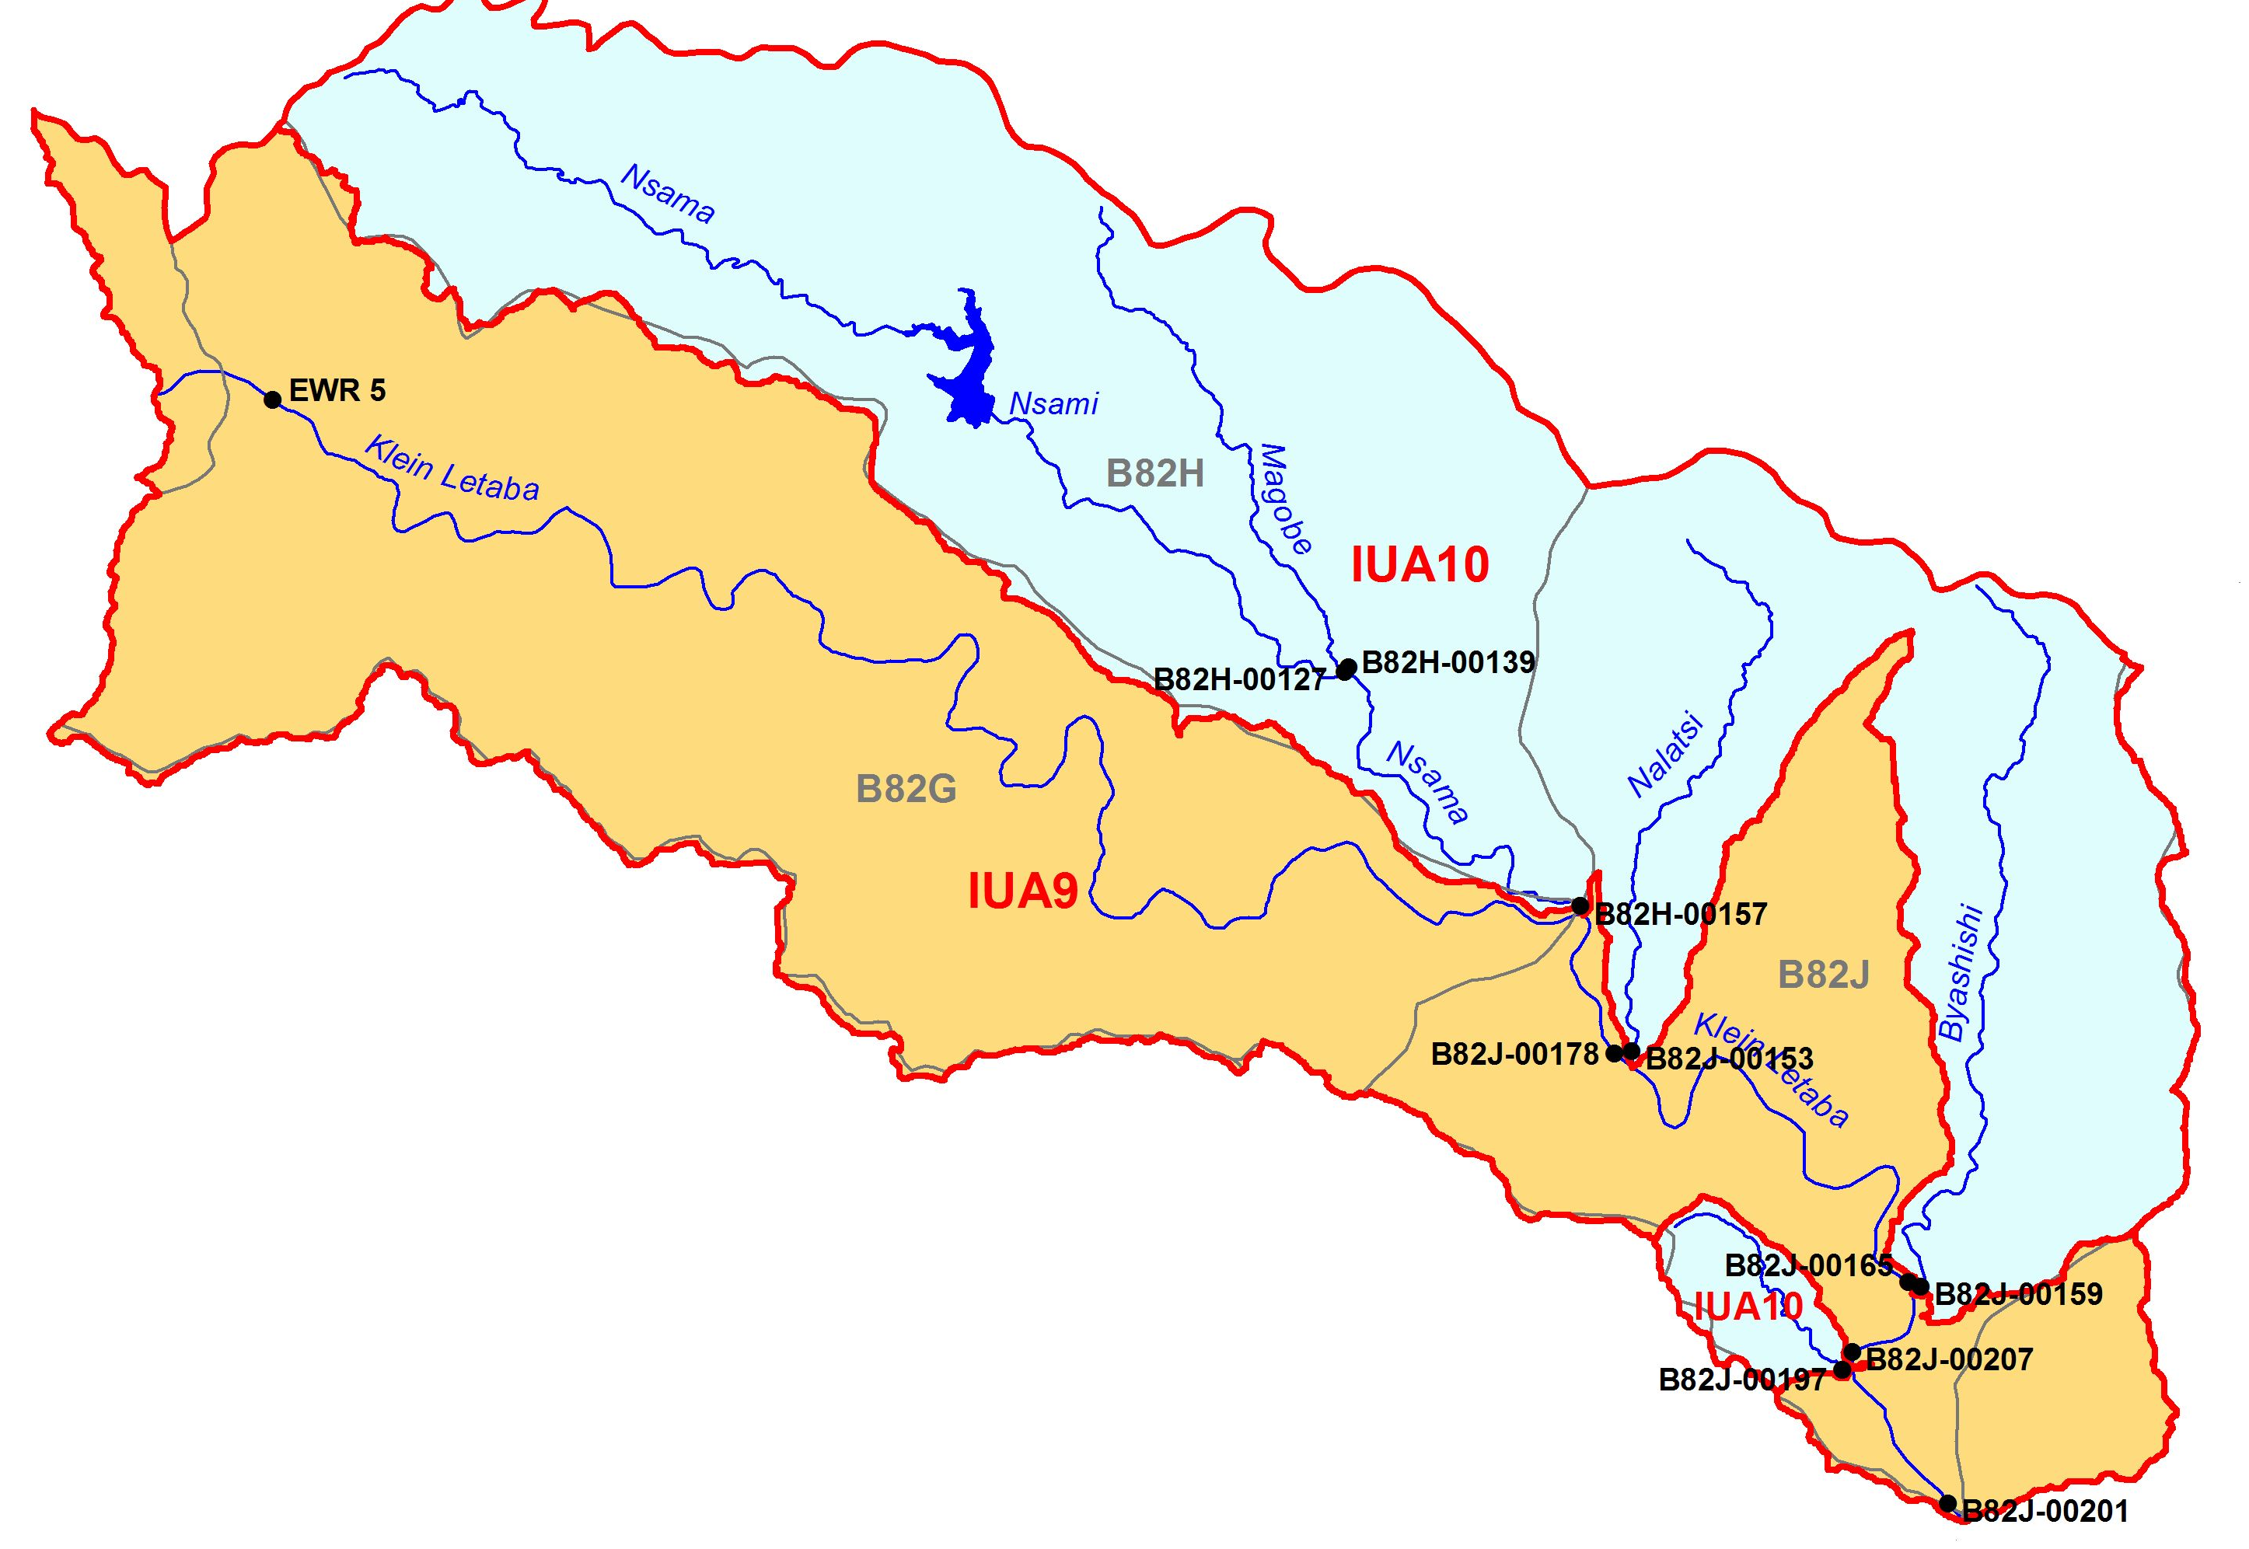
MC Klein Letaba DS of Middle Letaba Dam & tribs
IUA 10 (Lower Klein Letaba Tributaries)
Ephemeral tribs regulated by Nsami Dam. Urban and irrigation.
Mostly B & A EC.
Maintaining REC in MC will not impact on current economic activities
IUA 9 (Klein Letaba DS from confl with Middle Letaba)
Regulated by Middle Letaba Dam.
Mostly C EC and higher.
Sc 11 results in a C/D EC for main river with some increase in economics due to the building of Crystalfontein Dam.
MC I
MC III

Slide 18
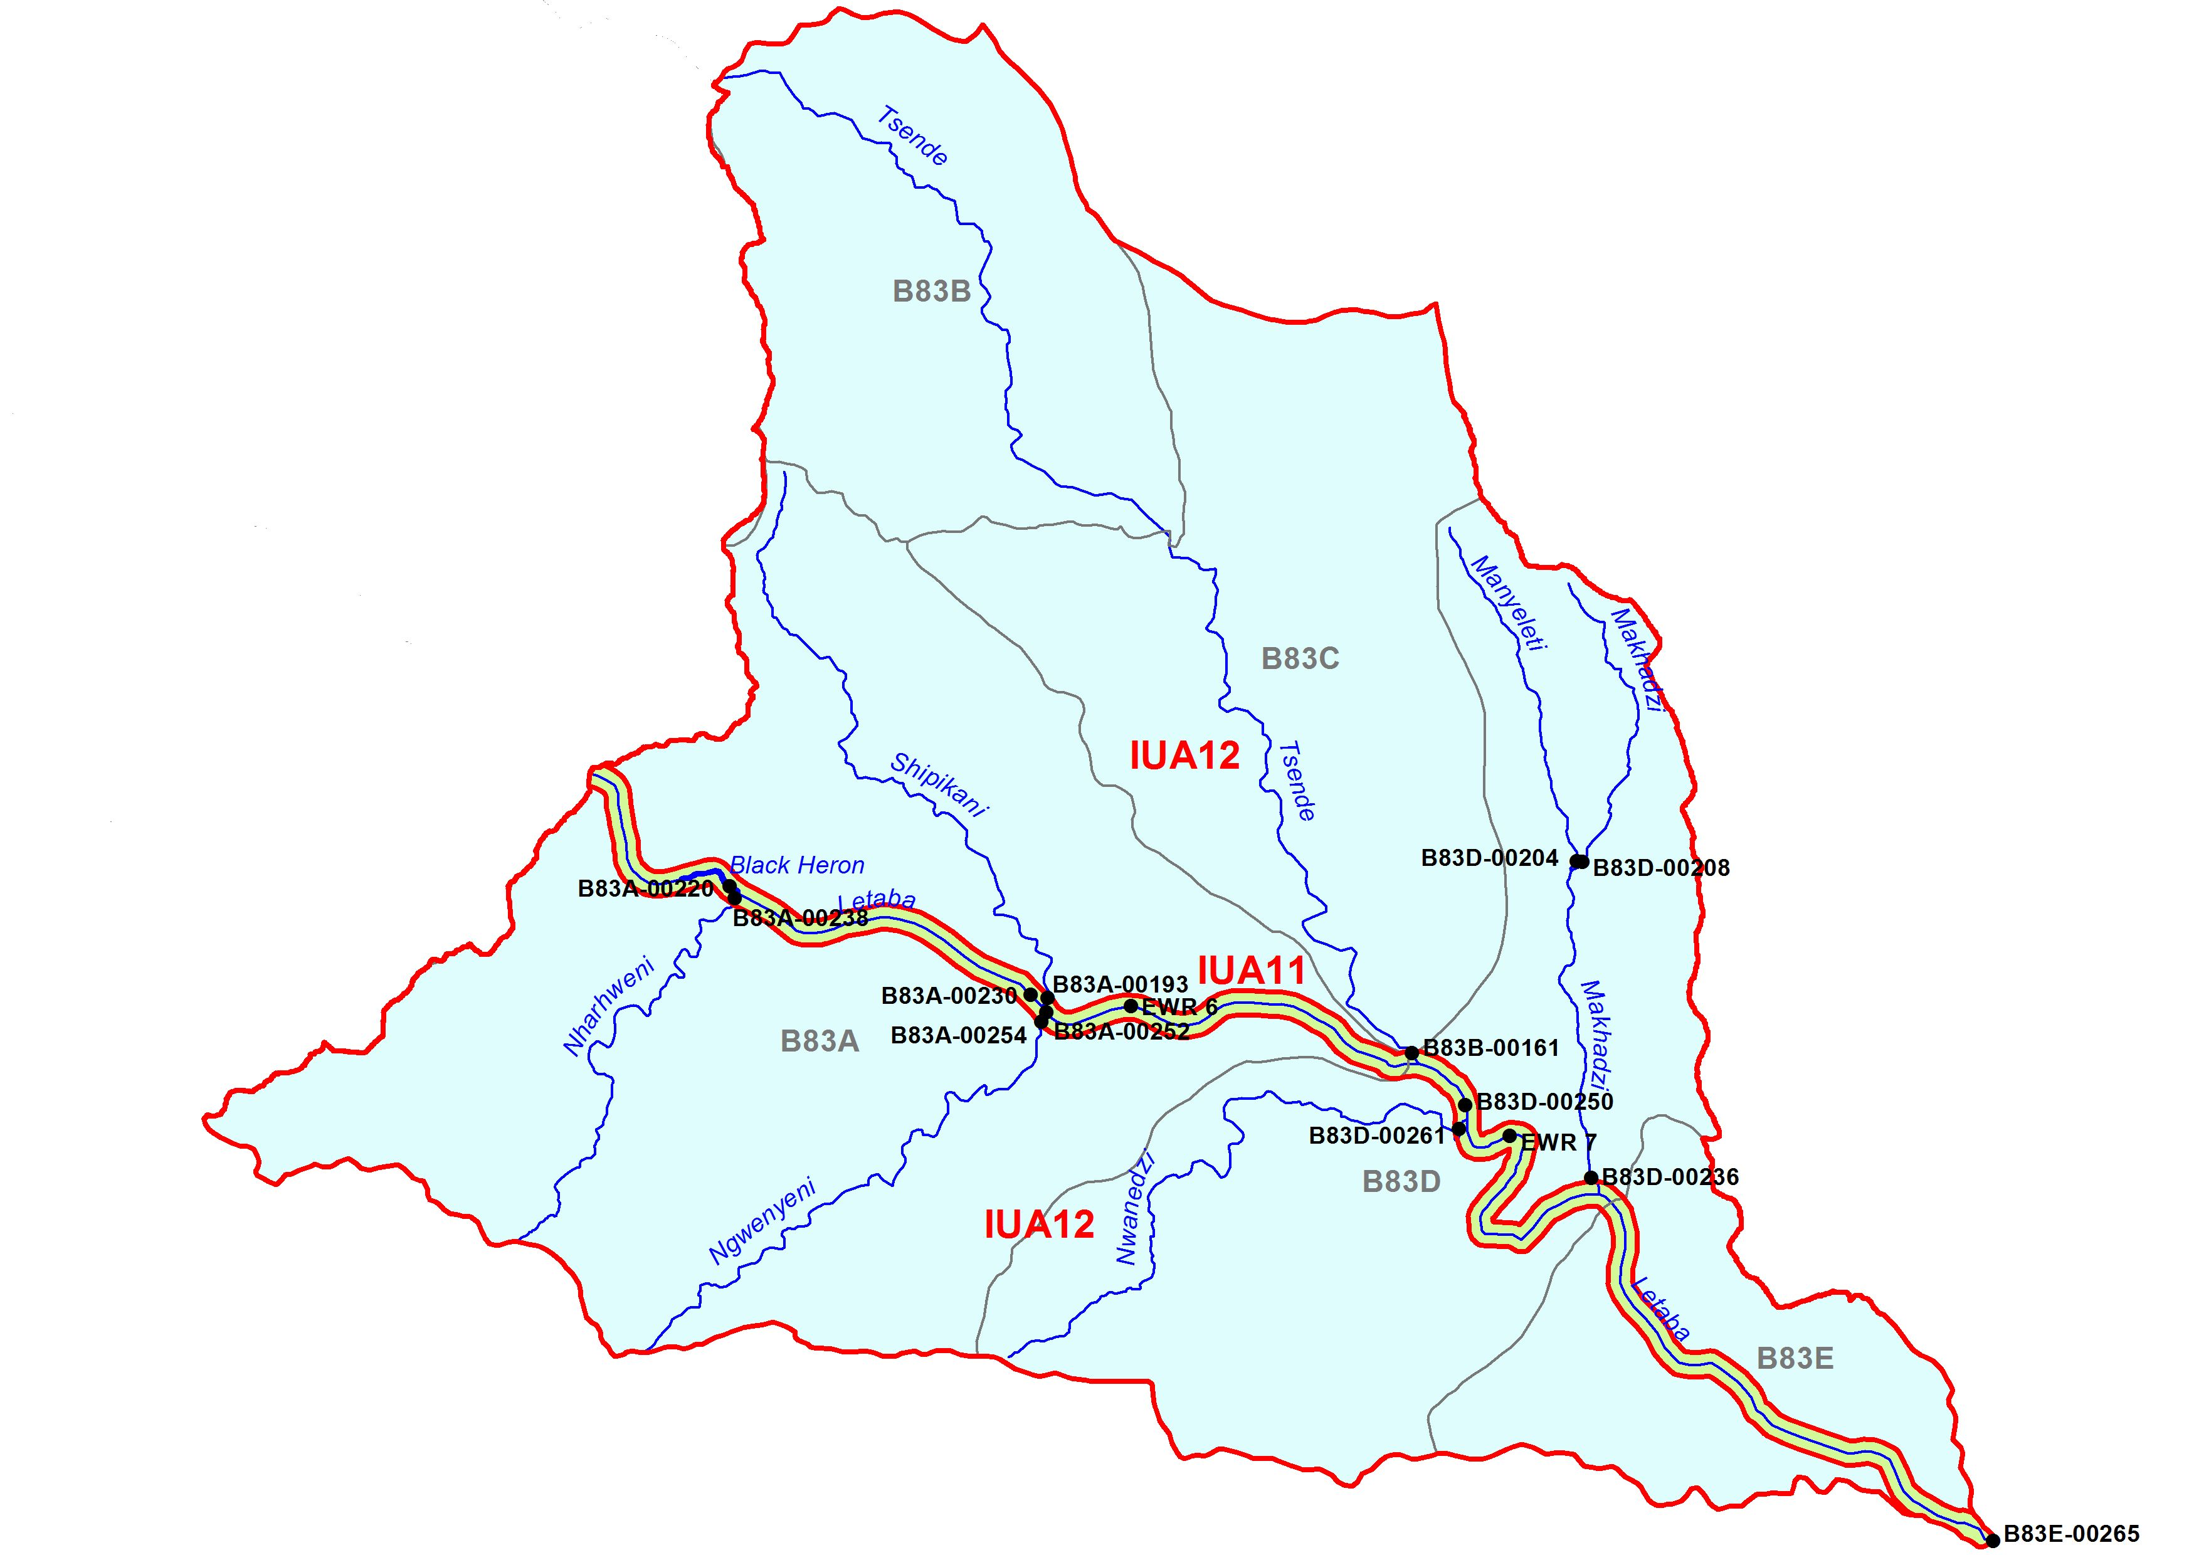
Implication of Management Classes
IUA 11 (Letaba in KNP)
Impacts related to upstream activities with key changes the flow regime change.
Mostly C PES with REC which requires improvement.
Implementing Sc 11 will maintain the overall C PES but drop the instream status to a lower EC (fish and invertebrates).
MC II
MC I
IUA 12 (Letaba tribs in KNP)
.Rivers completely in KNP. No impact. All in A PES and REC.
Sc no impact and MC I allocated to IUA

Slide 19
Perspective on Recommendations (1 of 2)
High flow releases from Nwamitwa Dam in January, February and March - outlets should be designed accordingly.
Release the PES low flows from the proposed Crystalfontein Dam into the Klein Letaba river.
Review and incorporate the recommended flows into the existing Ecological Release Operating Model.
Further large storage and abstractions, in addition to the Recommended Scenario, will most likely reduce the ecological health further and should be prohibited.

Slide 20
Perspective on Recommendations (2 of 2)
Further groundwater use has to be limited in catchments where abstraction can influence baseflow in accordance with the recommended EC.
Additional groundwater abstraction should be limited to Harvest Potential unless further investigations to quantify resources are undertaken.

Slide 21
Questions for clarification

